Slide 1

FUZZY LOGIC CONTROL OF WIND ENERGY SYSTEM
INT 247

Slide 2

AIM
To Predict the desired speed change in Turbine to make the constant and maximum Active Power from Fuzzy Logic.

Slide 3
PROGRAM FLOW
Importing Required Libraries
Fetch the Dataset (from Kaggle)
Edit Dataset to Make Model
Splitting Dataset (train & test)
Prepare the data to train the model
Selecting a desired model
Testing the model (on both train & test)
Fuzzy Controller (membership function)
Defining the rules
Desired Output

Slide 4
LIBRARIES
Numpy , Pandas , Matplotlib
Opendatasets , Os
Scikit-learn
: - train_test_split
: - RandomForestRegressor
Scikit-fuzzy

Slide 5
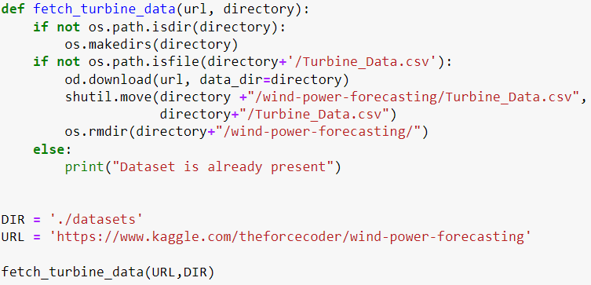
Datasets
Here we are Making a Directory to store the dataset (Turbine Data) which is downloaded from Kaggle .
If dataset already present it will not download again .

Slide 6
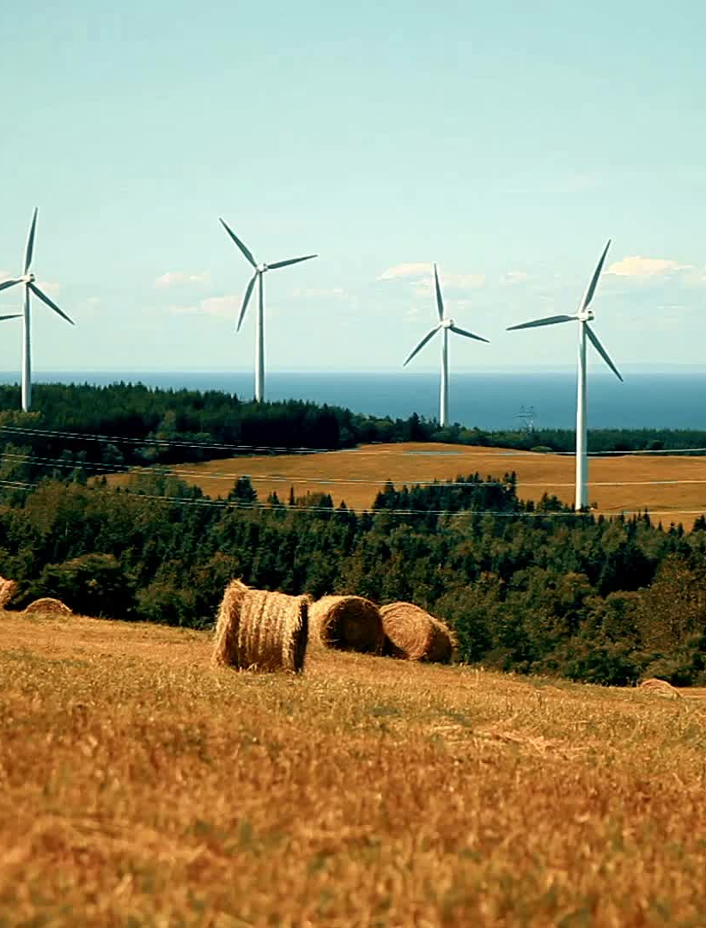
Turbine Data
It is a CSV file downloaded from Kaggle .
It contains various weather, turbine and rotor features. Readings have been recorded at a 10-minute interval.
It has the data like ActivePower , AmbientTemperatue , WindDirection , WindSpeed and more in columns .
Every 10-minute interval data has been stored as Rows.
It has 22 Columns and 118225 Rows.(Two-and-half years data for a windmill)

Slide 7
Edit Dataset
There are some Columns in Dataset which are in the object type so we have to update that to numeric type .
There are some Items in Dataset which are null and numeric type so we have to replace that with the median of their column .
There are some Items in Dataset which are null and non-numeric type so we have to replace that with numeric value 0.
We have to make separate columns for every DateTime Parameters.

Slide 8
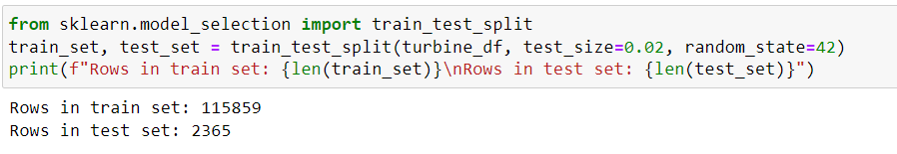
Splitting Dataset
We have to split the data set two parts Training dataset and Testing dataset
Training dataset help our model to learn from data After Completing the model Testing dataset help to check our model on new data which is not their in train dataset .
After that if the model gives us the less error then our model is ready.

Slide 9

Train the Model
We have to learn the model from the train dataset so we had made separate variable for the output column (Active Power) and give the remaining data to train .
Later on after completing the model we have to check the model from Active Power.

Slide 10
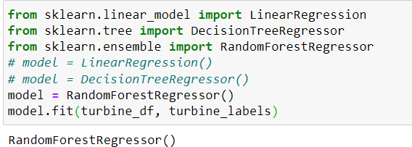
Selecting Model
We have to select a Model which will give the less error to produce Active Power.
We have tested Liner Regression, Decision Tree Regression but these two give more error than Random Forest Regression so we use this.

Slide 11

Testing the model
First we have to test with his data so we had first tested from train dataset it self , and the model predicted correctly.
Then we have tested with the test dataset and also our model gives the correct data.
So till here our model is done. Now we have to work on Fuzzy.

Slide 12

Fuzzy Controller
Here we have defined the membership function for the change in rotational speed of generator .
And defined the membership function for the active power.
After that we have defined the Rules for Fuzzy Controller.

Slide 13
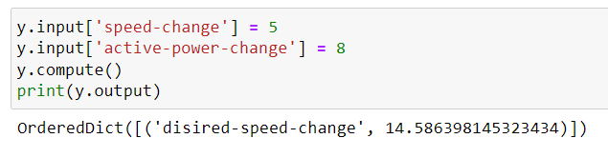
Desired Output
Here we have two input change in active power and change in speed
After giving the input fuzzy calculate the output and tell the desire speed change to make constant and max Active Power.

Slide 14


